Slide 1
English Writing II
Week 13 Starting a research

Slide 2
Final term paper
Conduct a small-scaled research on a topic/ an issue related to the Covid-19 pandemic.
An empirical study with first-hand data and replicable methodology.
IMRD structure
Academic style

Slide 3
Lesson plans
Week 13: Research questions and the IMRD structure
Week 14: Research method
Week 15: Research results and discussion
Week 16: Abstracts, references, and course summary

Slide 4
What is research
Research is "creative and systematic work undertaken to increase the stock of knowledge, including knowledge of humans, culture and society, and the use of this stock of knowledge to devise new applications." It is used to establish or confirm facts, reaffirm the results of previous work, solve new or existing problems, support theorems, or develop new theories.

Slide 5


Slide 6
Research topic
What is the best way to travel from HZ Railway Station to Zijingang Campus?
→ The fastest? The cheapest? The most comfortable? …

Slide 7
Research Question
Specifying the RQ is the methodological point of departure of scholarly research in both the natural and social sciences. The research will answer the question posed.

Slide 8
Why are RQs so important?
A research question is the fundamental core of a research project, study, or review of literature. It focuses the study, determines the methodology, and guides all stages of inquiry, analysis, and reporting.

Slide 9
Research questions should be …
Feasible.
Clear.
Significant.
Ethical.

Slide 10
Not-so-good RQs
“The term paper” (taking on too little)
→ How many high school seniors enlisted in the military prior to 2002 graduation?
“The Black Hole” (taking on too much)
→ The Effects of 911 on High School Seniors

Slide 11
Examples: drafting the RQs
Initial RQ:
→ What effects did 911 have on the future plans of students who were high school seniors at the time of the terrorist attacks?

Slide 12
Examples: drafting the RQs
Revised RQ (measurable yet biased)
→ Did seniors consider enlisting in the military as a result of the attacks?
→ Did seniors consider colleges closer to home as a result?

Slide 13
Examples: drafting the RQs
RQ revised (neutral)
→ What is the association between 911 and future plans of high school seniors?

Slide 14
In-class writing 1301 (10 minutes)
Write 2-3 RQs that you want to address in a small-scaled project
Stay clear, simple, and feasible
Share on DingTalk

Slide 15
Academic writings
The report paper – to summarize and to report
The thesis paper – to evaluate and to discuss
A research proposal – to propose and to justify
A dissertation – a document submitted in support of candidature for an academic degree or professional qualification presenting the author's research and findings.

Slide 16
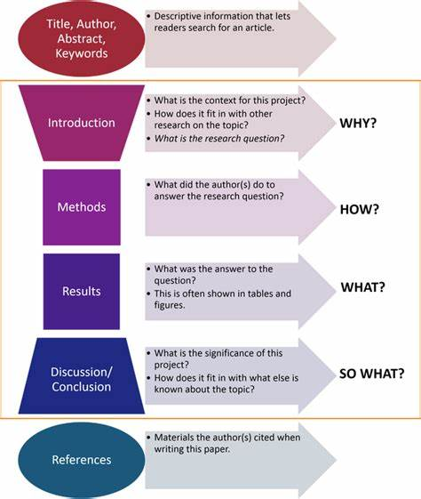
IMRD structure

Slide 17
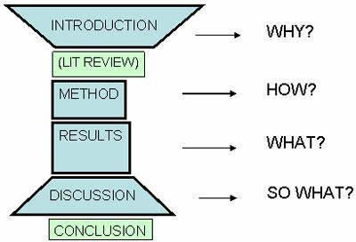
IMRD variations

Slide 18


A sample article
Critical Period Hypothesis (2018).pdf

Slide 19
Assignment – RQs
Propose one or two research questions that you want to address in the small-scaled project.
Extended project based on your Project 2, or
A new project (with sufficient information and knowledge)

Slide 20
Assignment – Research Method
How to obtain the data
What kind of tools/ materials?
Who/what are the subjects? How many? How to find them?
What about the procedure? How long and in what order?
How to analyze and present the data?

